Slide 1
Anthony and Alissa Craft

Slide 2
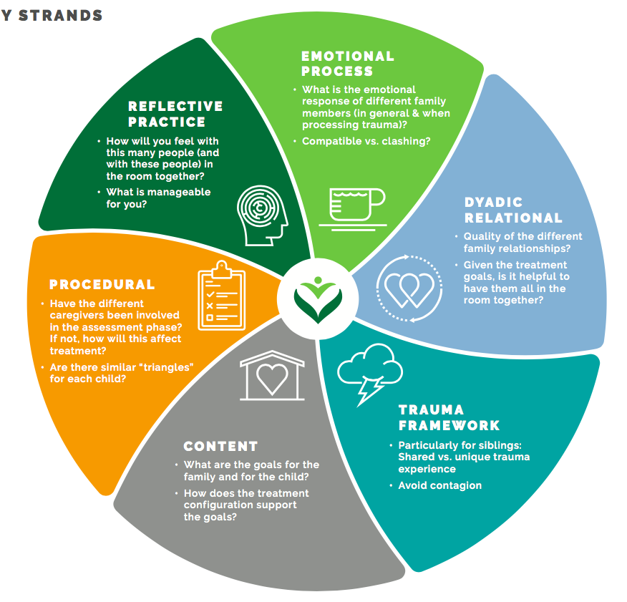
CPP Fidelity: Six Interconnected Strands
Six Strands of Fidelity
Reflective Practice
Emotional Process
Dyadic Relational
Trauma Framework
Procedural
Content
Ghosh Ippen, Van Horn, Lieberman, 2016
Notes:
SLIDE TYPE: Core
RATIONALE:
Rapidly name the 6 strands of fidelity
KEY POINTS:
There are 6 strands of CPP fidelity
Strands are inextricably linked like DNA
They are the blueprint (DNA) for the model
OPTIONS:
The slide is meant to go very fast – just to introduce the concept

Slide 3
Anthony and Alissa Craft
Anthony and Alissa Craft are 34-month-old White twins referred to treatment by their CPS worker. They were born premature at 29 weeks’ gestation and were removed from their mother at birth due to her substance abuse. Both twins had numerous medical issues and remained in the NICU for 1 month after their birth. Anthony was fed via a nasogastric tube. At 1 month old, they were released from the hospital to a foster family who cares for high-risk babies. They remained in that home until they were 7 months old, when they were returned to their biological mother. They were removed from her care 5 months later (at 12 months old) due to exposure to severe domestic violence. It was reported that mother’s boyfriend stabbed her with a knife and threatened to kill her and the children. Anthony and Alissa were placed in three different foster homes during the following year and were returned to their mother when they were 2 years old. Six months later, they were removed after their mother attempted suicide. She slashed her wrists.
Ghosh Ippen, Van Horn, Lieberman, 2016
Notes:
TRAINER NOTE
We strongly suggest that you use this case unless you have a comparable one you would like to use. Ideally that case would involve siblings so as to allow for a discussion about treatment configuration later on.
The case was written with the following thoughts in mind.
The details are designed to be triggering to lead to a discussion of how therapists will get support as they begin to do this work
It also allows the group to begin thinking about working with siblings and whether they should be seen together or separately
You should know that the case has a write-up using the CPP template that can be shared with participants. There is likely not enough time to go through the write-up during training, but it is one that is often used on early calls before people have cases and can also be used by the team in their own meetings.
SLIDE TYPE: Core Content
RATIONALE:
Share a case that is somewhat triggering to help facilitate a discussion about what it is like to do this work and the types of supports that people will need
KEY POINTS: Main points to highlight for learning
OPTIONS:
You can choose to read the slide aloud as a group or have them read it at their tables and then discuss it. There may be something though to reading it out loud in that we it provides the group with a shared experience of being “hit” by the case although each person may have their unique reaction.

Slide 4
Anthony and Alissa Craft (continued)
Medical exams revealed that Anthony had bruises on his body and an x-ray showed prior tibia trauma. Anthony and Alissa were placed in foster care with Gina and Kerri who hoped to adopt them although they were concerned about keeping Anthony because he was very difficult to manage.
Anthony is extremely aggressive and has prolonged and unmanageable tantrums. He hits, kicks, spits at people, and throws things. He is hyperactive and has difficulty following any instructions. His speech is delayed, and he is not potty trained. Alissa is shy and approaches people slowly, but once she warms up, she is very engaging and talkative. Her foster mothers notice that Alissa engages in odd sexual behaviors. She tries to kiss them with her tongue, and she often rubs her vaginal area. The children’s biological mother is still trying to reunify with the children, and it is unclear as to whether her parental rights will be terminated.
Ghosh Ippen, Van Horn, Lieberman, 2016
Notes:
Vignette continued:
The details continue to really show the type of information that therapists hear. This is particularly important if there are systems leaders participating as it enables a discussion regarding how to support therapists as they do this work.

Slide 5

Reflective Practice
What comes up for you after reading this referral?
What are your treatment considerations?
What supports will you need?
Ghosh Ippen, Van Horn, Lieberman, 2016
Notes:
SLIDE TYPE: Optional
RATIONALE: Offer questions for discussion after people hear the case
OPTIONAL
Can be done in small groups (time permitting)
Sometimes we have done this by agency (so people from the same agency can think together).
Other times we have done in groups separated by role (groups of therapists, supervisors, and senior leaders meet separately)
Participants can use the next slide to write down some of their thoughts.

Slide 6
Random Assignment to Fidelity Strands
Reflective practice
Emotional process
Dyadic relational
Trauma framework
Note:
The information in the template is there because the clinician had good procedural fidelity
We will use this case in the future to think about content fidelity

Slide 7
Instructions
Imagine you are in a supervisory role or consulting as a peer
Read through the template
Keep your fidelity strand in mind
You may want to read through the questions on the CPP Fidelity Compass
Highlight places in the template, where you might wonder with the clinician about that particular fidelity strand
On the top of page 6, rate your level of challenge and capacity with regard to your strand.
Talk in small groups with others assigned to that strand
Return to the large group to and share
  What the fidelity strand means to you, how it guides you
  Places in the template where you might help the clinician think about that strand of fidelity

